Slide 1
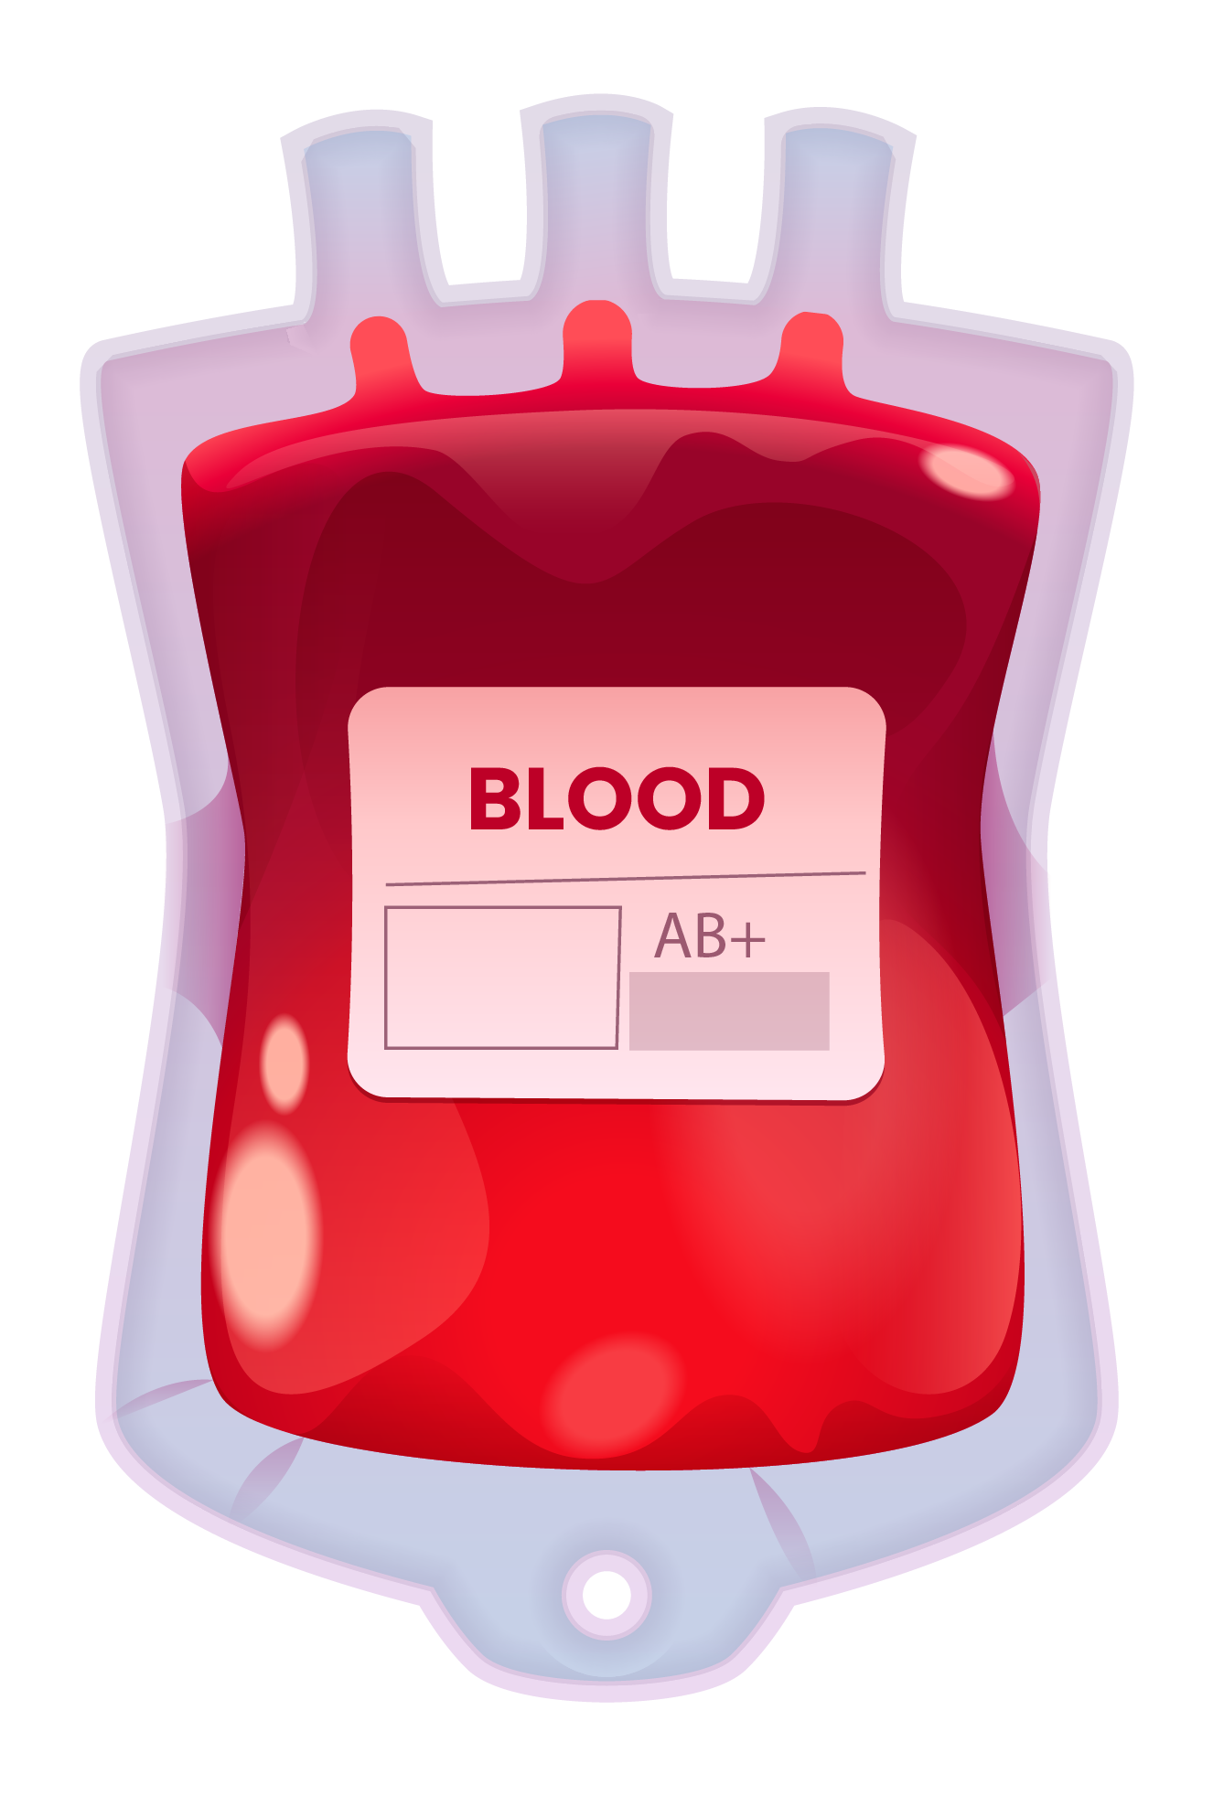
BLOOD TRANSFUSION
IMPLEMENTATION OF AUTOML TOOL (TPOT)
GROUP : 8

Slide 2

CONTENTS
Problem Statement
Team Profile
Importance of Blood Transfusion Prediction
Approach to achieving the goal
Implementation
With or Without AutoML
Future scope of the project

Slide 3
PROBLEM STATEMENT
Blood transfusions are a critical aspect of the medical industry, and the timely availability of blood is crucial for saving lives. However, the manual process of blood transfusions can be time-consuming and result in delays that may cause adverse consequences. Automating the blood transfusion supply chain through machine learning techniques can improve the efficiency of blood banks and health agencies in organizing blood donations.
The aim of this research is to predict the likelihood of individuals donating blood in future blood donation camps based on their blood donation history. To achieve this objective, we will use a publicly available dataset of blood donations and train multiple machine learning models to identify the factors that influence an individual's decision to donate blood. We will then optimize the parameters of the models and evaluate their performance using appropriate metrics.

Slide 4



TEAM PROFILE
KISHAN PATEL
TILAK PANDYA
NAMRA PATEL
(B.Sc. Physics, PGDCA, Big Data Solution Architecture)
(B.C.A., M.C.A.)
(B.E. Computer Science)

Slide 5
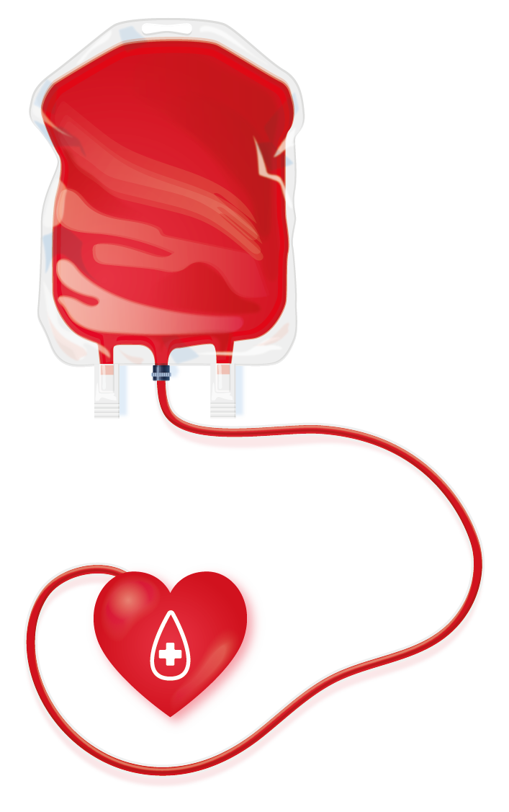
IMPORTANCE OF BLOOD TRANSFUSION PREDICTION
In the industrialized world, the majority of blood donors are unpaid volunteers.
This means that in order to maintain healthcare services, blood banks, hospitals, and the government heavily depend on the generosity of the donors.
It is exceedingly difficult for these institutions to deliver high-quality healthcare services without sufficient blood from such donors and blood donor organizations.
Lack of blood supplies can result in life-threatening circumstances.
If blood collecting organizations have an estimate of how much blood can be gathered, they can plan and utilize resources effectively in organizing blood donation camps.
Accurate blood donation forecasting can aid organizations in preventing shortages and ensuring that there is enough blood to satisfy demand.

Slide 6






APPROACH TO ACHIEVING THE GOAL
In order to start exploring about the problem deeply, we have gone through 3 research papers which are mentioned below.
A survey on machine learning algorithms for the blood donation supply chain - https://iopscience.iop.org/article/10.1088/1742-6596/1362/1/012124/pdf
Knowledge discovery on RFM model using Bernoulli sequence: https://www.sciencedirect.com/science/article/abs/pii/S0957417408004508?via%3Dihub
Predicting blood donations using machine learning techniques-http://matthewalanham.com/Students/2017_MWDSI_Final_Bahel.pdf

Slide 7
APPROACH TO ACHIEVING THE GOAL
Traditional machine learning algorithms and AutoML (using TPOT).
We will tune the hyperparameters of the traditional ML algorithms to maximize their accuracy.
We will also compare the results obtained with and without using AutoML.
Additionally, we plan to create visualizations that show the predicted blood donation rates in different locations.

Slide 8
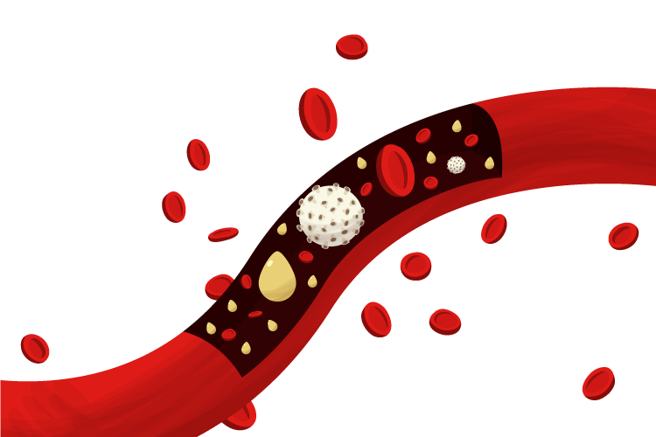
INTRODUCTION
TO TPOT
TPOT AutoML is an open-source library for automated machine learning. It uses genetic programming to search for the best combination of preprocessing steps, feature extraction, and machine learning algorithms for a given dataset, saving time and effort for data scientists and analysts.
With TPOT AutoML, users can easily optimize their ML pipelines and create highly accurate models for various tasks such as classification, regression, and clustering. It automates the model selection process by evaluating the performance of multiple pipelines and suggesting the best one for a given problem.

Slide 9
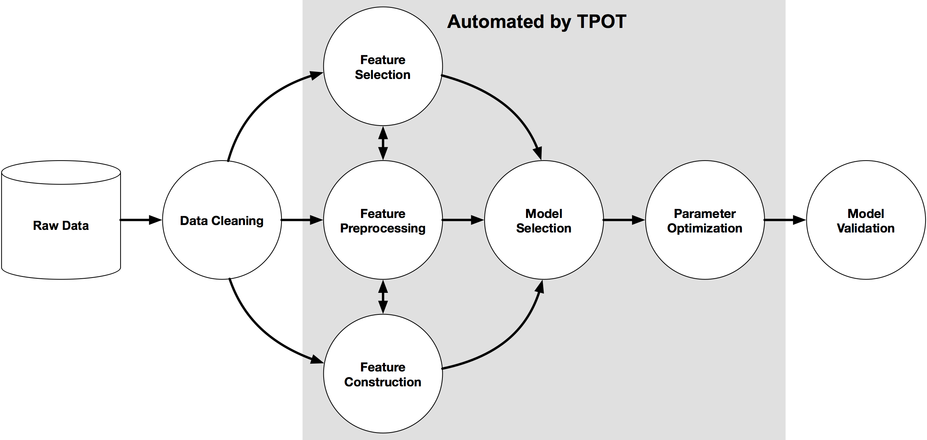
IMPLEMENTATION OF TPOT

Slide 10
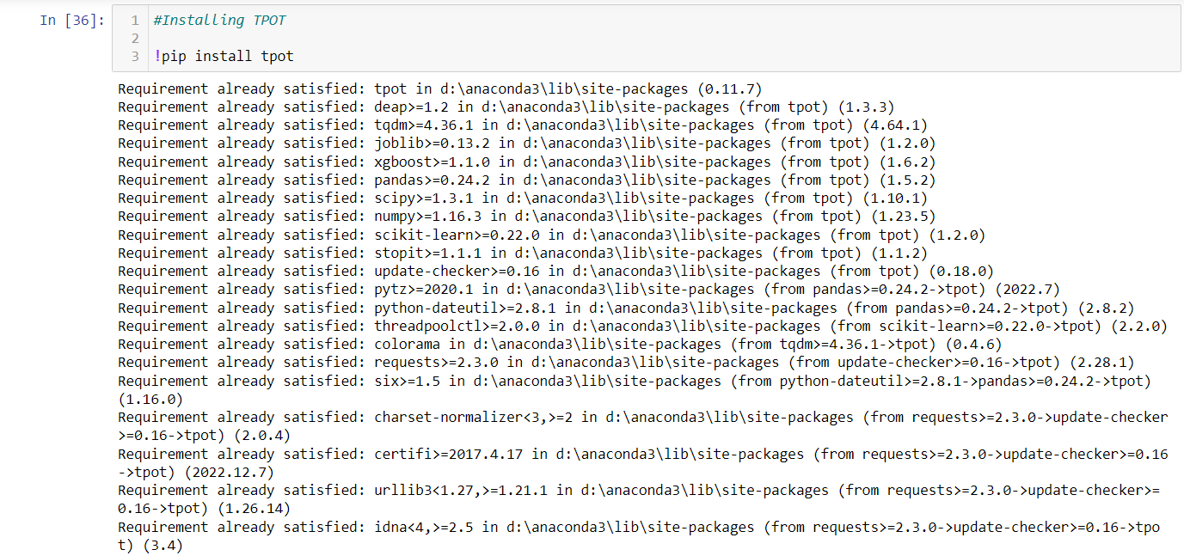
IMPLEMENTATION OF TPOT
Installing the TPOT

Slide 11
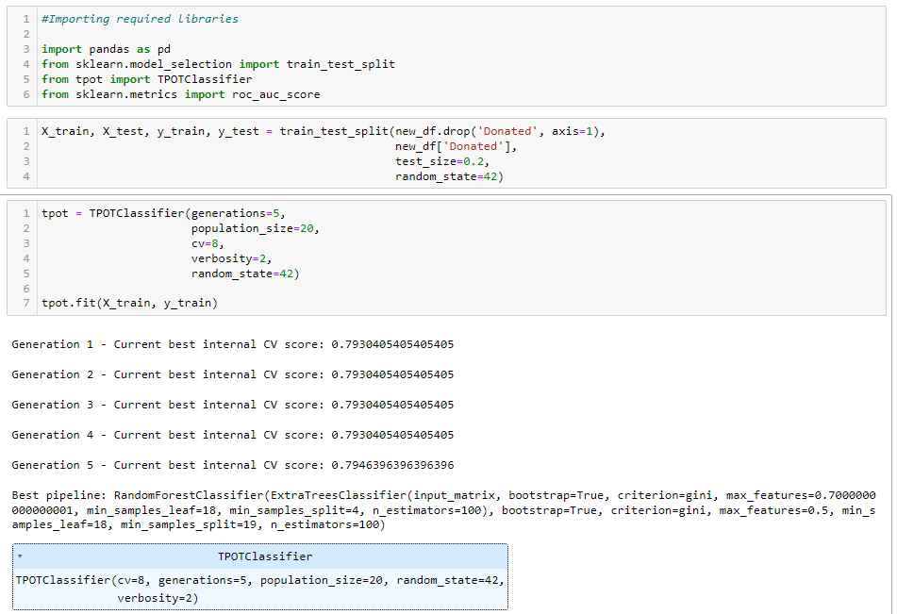
IMPLEMENTATION OF TPOT
Importing required libraries
Splitting the dataset
Implementing TPOT Classifier

Slide 12
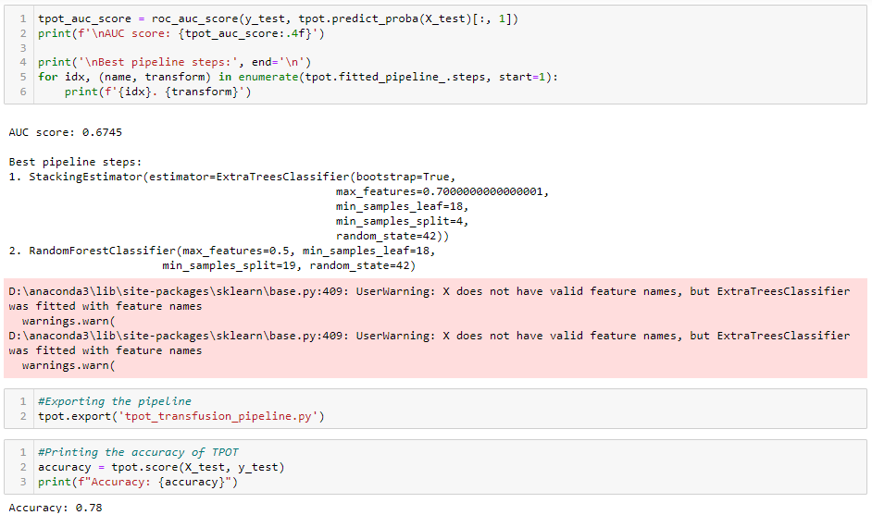
IMPLEMENTATION OF TPOT
Results of TPOT

Slide 13

WITHOUT TPOT
Without TPOT, we have used Logistic Regression and Random Forest. In which we chose Random Forest since we got 81% accuracy.
WITH TPOT
With TPOT, we get 78% of accuracy. And the suggested model is Random Forest Classifier.

Slide 14
ML PREDICTION & OUTCOMES
1. What did the research tell you? What ended up being your goal/solution?
According to TPOT, the pipeline steps suggested by it can lead to the ideal model selection. The first step would be StackingEstimator(estimator=ExtraTreesClassifier), followed by Random Forest classifier. The accuracy of TPOT is 78%. In the initial studies (Assignment 1), we have chosen the Random Forest Classifier as our ideal model.
This study states that using Random Forest we can be 78% accurate predicting whether blood donors are likely to donate in future or not. Based on the location and people, we can target specific area and time to held the blood donation camps to automate and boost the blood transfusion supply chain. Updating and experimenting with different parameters, our approach would be in the favour of using Random Forest in the future.
2. Does your prediction match with expectation using your designated AutoML, thus far? What were research results? Do you have results of your own yet?
The model which we chose in the initial study is also suggested by TPOT pipeline, however, model needs further improvements. Our expectations are bit higher than the predicted results (AUC score being 0.6745, and accuracy being 78%) that we get using TPOT.

Slide 15
FUTURE SCOPE OF THE PROJECT
We can preprocess the data in such a way that it eliminates the outliers if found any.
We can balance the dataset in such a way that we get similar counts for the class.
We can further fine-tune the hyperparameters to increase the model's accuracy.
We can follow the pipeline suggested by the TPOT.
We can obtain real data from the government or blood donation groups, then train our model using that data.
The entire pipeline of this procedure can be automated. This implies that a working model will continue to gather data following each blood donation drive across all blood donation camps and use it to improve the accuracy of the current model. This improved model will then be used for subsequent blood collection drives.

Slide 16
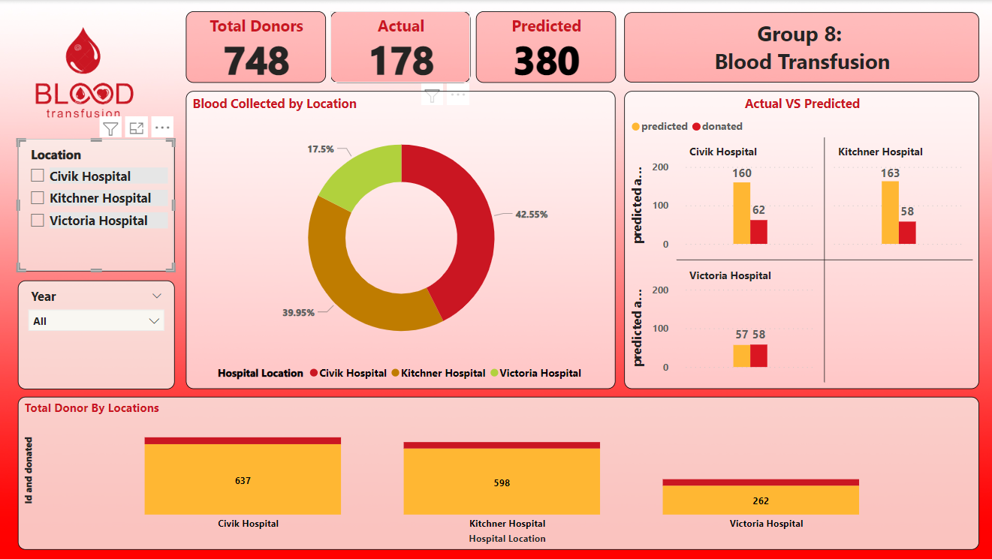
DATA VISUALIZATION

Slide 17
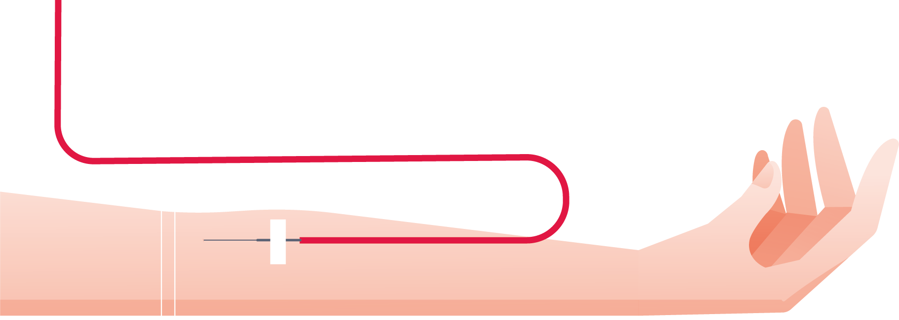
THANK YOU

